Slide 1
8th Grade Technology
Unit 1 – Introduction
Section 1 - Syllabus Overview And Classroom Operations

Slide 2
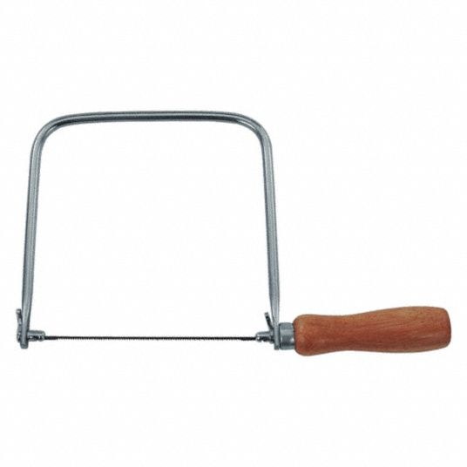
DO NOW
Name this tool

Slide 3
The big idea
Introduce the course syllabus to know what units and sections are scheduled and what assignments are due.
Introduce classroom operations and procedures for a safe and exciting working environment.
Google Classroom usage

Slide 4
Course grading weight
CATEGORY | WEIGHT
Assignments | 62.5
Do Now's | 2.5
Presentations | 7.5
Pretests | 0
Tests | 27.5

Slide 5
Course Syllabus
Breaking down by UNITS and SECTIONS
A test is provided before and at the end of each unit
Units
Safety
Design Process
Exploring Technology
Design and Engineering
Manufacturing For Masses
Technology Systems
CAD

